Slide 1
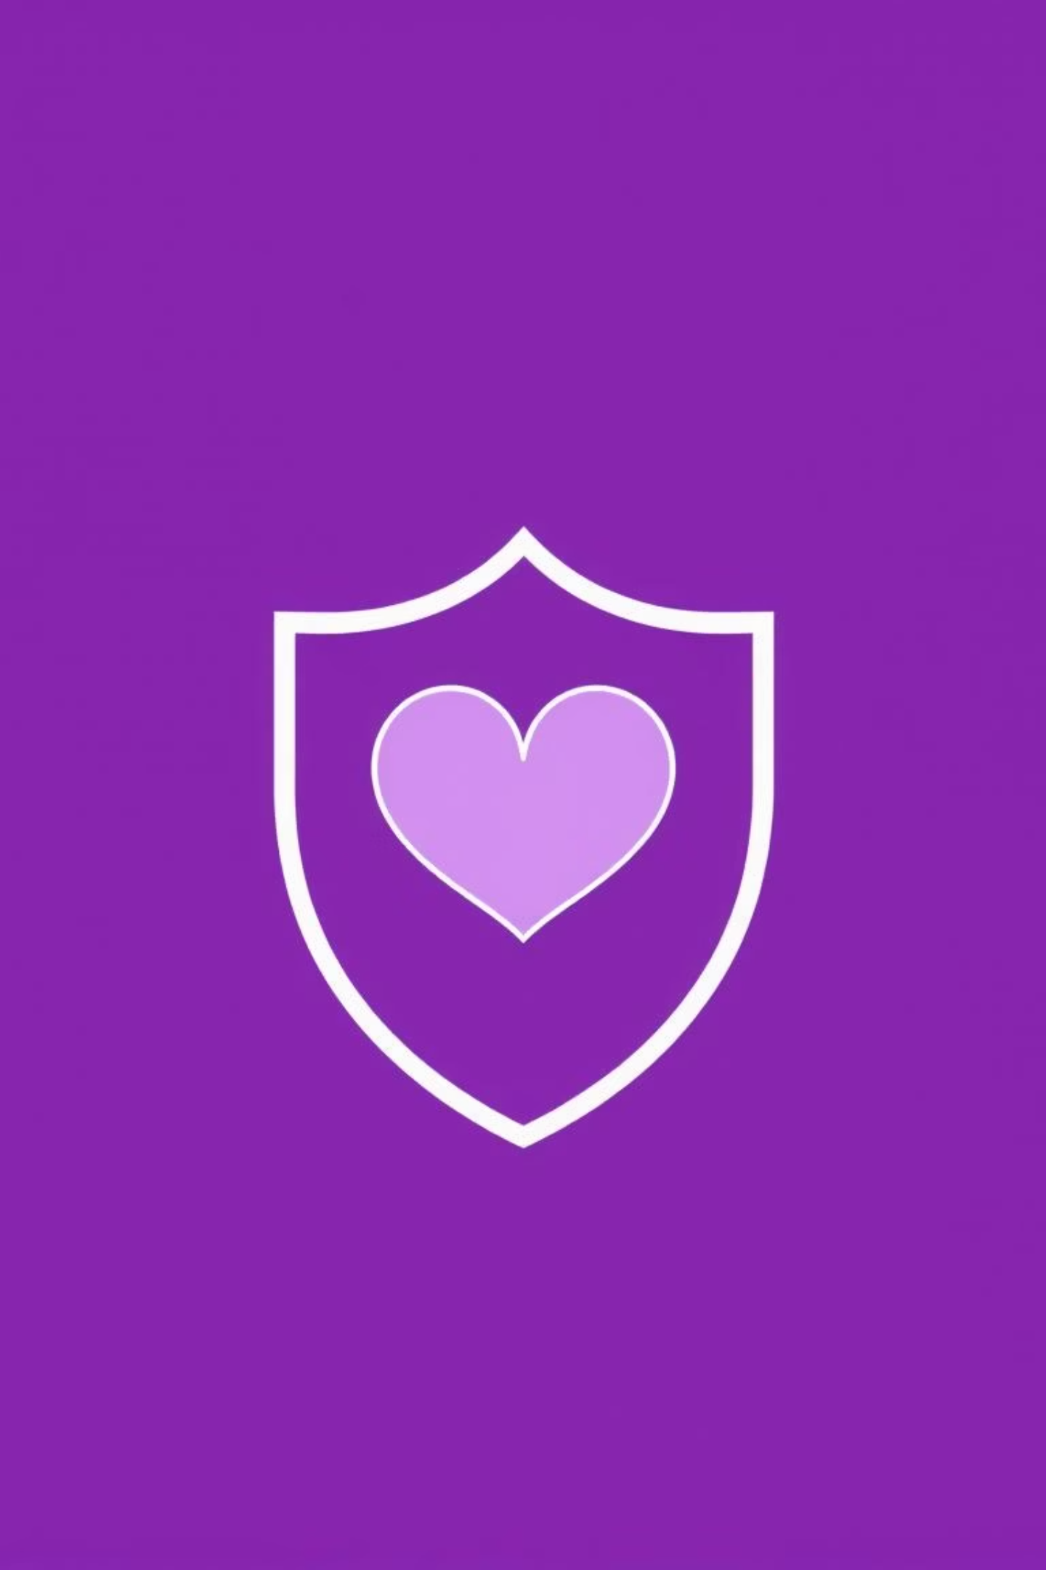
Love-Chain : Decentralized Dating Application
Date with Confidence.
Why Web2 Dating Apps Fail:
Fake Profiles & Catfishing: Anonymity breeds deception.
Data Privacy Risks: Your personal life, exposed.
No User Accountability: Harassment goes unchecked.
Safety Concerns for Meetups: Real-world dangers, unmitigated.

Slide 2
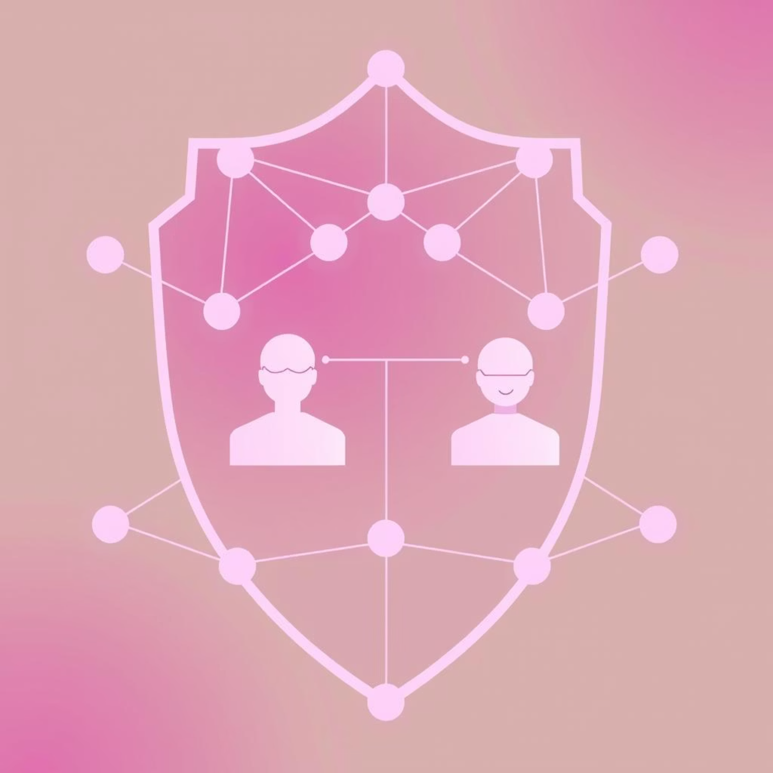
Why Blockchain?
Verifiable Identity
On-chain profiles drastically reduce bots and fake accounts.
User Empowerment
You own your data and interactions, not the platform.
Transparency & Trust
A system of accountability for all users, fostering genuine connections.
Seamless Login with Petra Wallet
One-click, password-free sign-in for a secure and easy start.

Slide 3
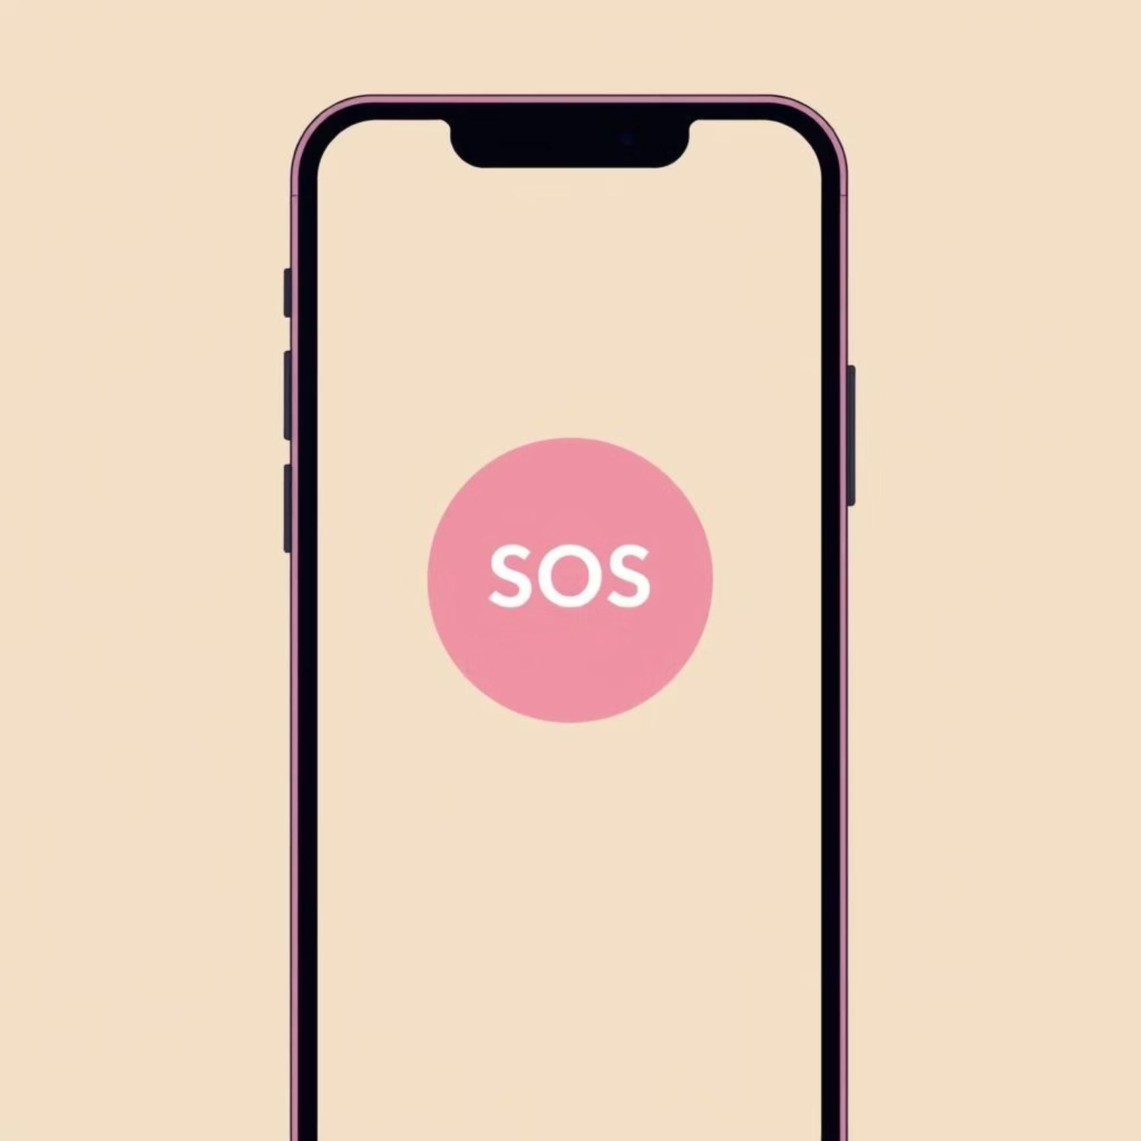
Trust & Safety
Your Emergency SOS
Feel unsafe on a date?
Press the SOS Button: Instantly shares your live location via SMS/email.
Alerts your pre-set emergency contacts (friends & family).
This feature provides peace of mind, knowing help is just a tap away.

Slide 4



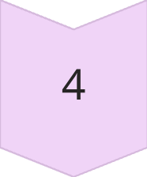


How It Works: Your Safe Dating Journey
Start
Download the Lovechain app and get ready to connect.
Sign In (Petra Wallet)
Securely log in with your Petra Wallet for a truly private experience.
Set Up
Create your verified profile and designate emergency contacts.
Find a Date
Discover authentic connections with confidence.
On Date?
Enjoy your meetup, knowing you're protected.
Feel Safe?
No
Yes
Press SOS: Instant location sharing & alerts.
Have Fun! Enjoy your secure connection.
Alerts Contacts: Help is on its way.
Return to App: Ready for your next match.

Slide 5

Join the Future of Dating
Simple Steps:
Download the Petra Wallet.
Create your secure identity.
Log in to Love Chain with one click.
Set up your profile and emergency contacts.
Start connecting authentically and safely.
Thank You

